Slide 2
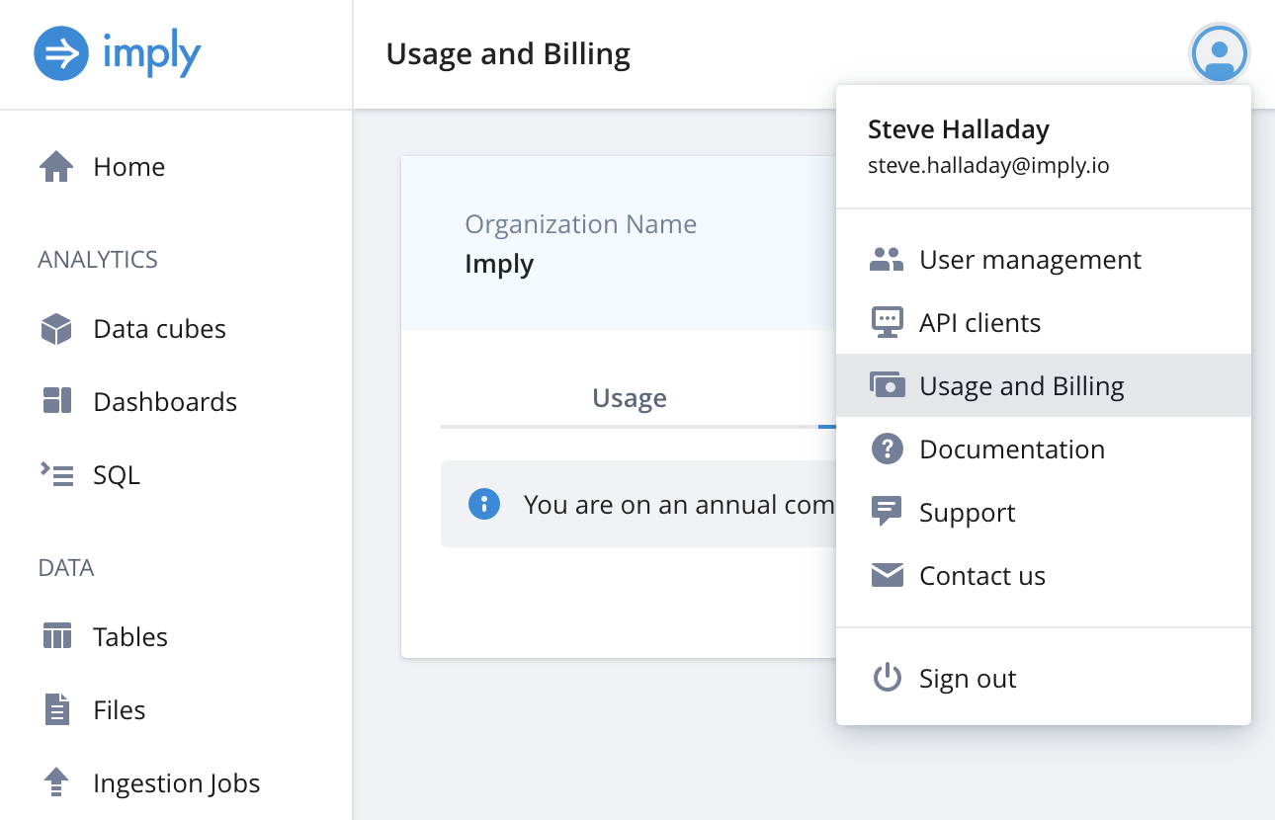


Click here
Then, click here
Find the organization name here

Slide 3
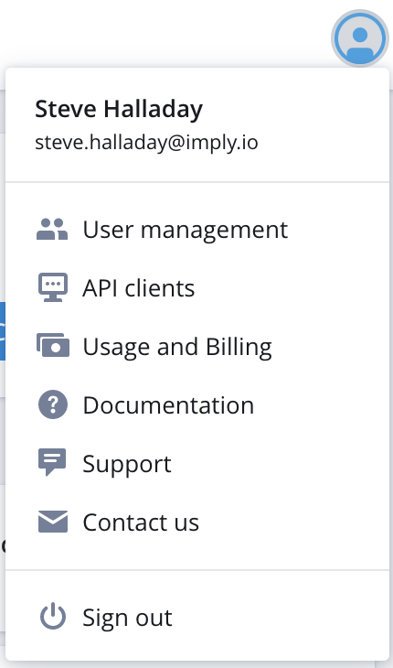

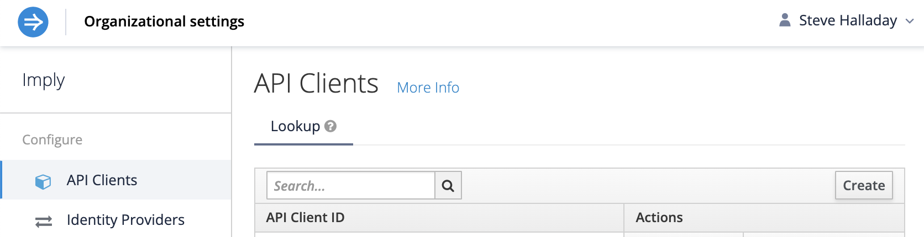
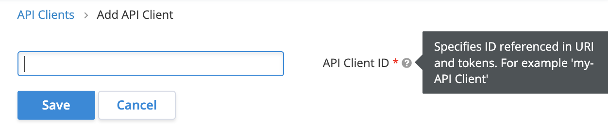
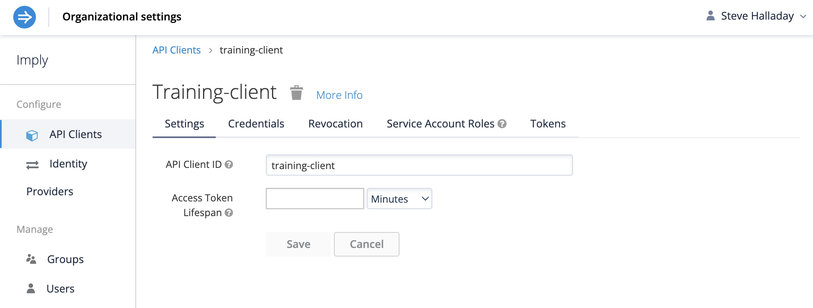
1 - Click here
2 - Click here
3 - click here
4 – Fill in the API client ID
5 - Click here
6 – Fill in the lifespan
(60 minutes ought to work)
7 – Click here

Slide 4
6 – Fill in the lifespan
(60 minutes ought to work)
7 – Click here

Slide 5
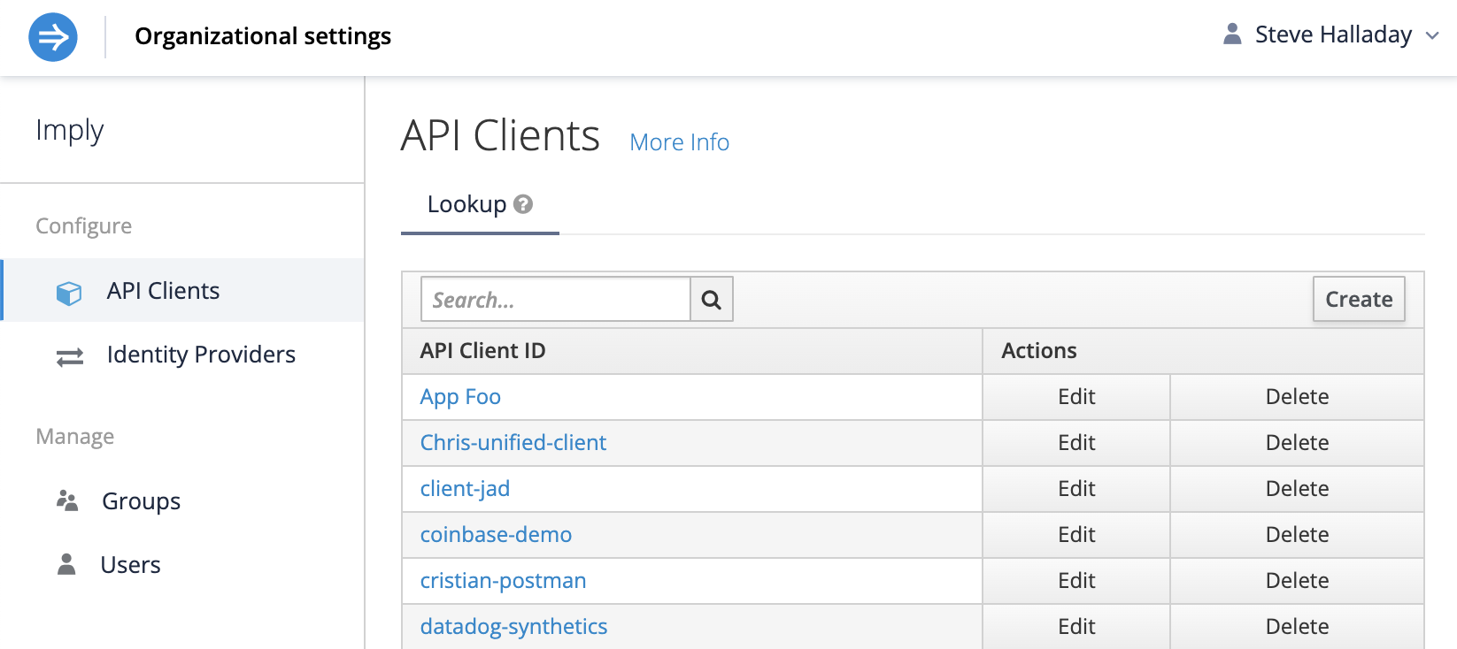


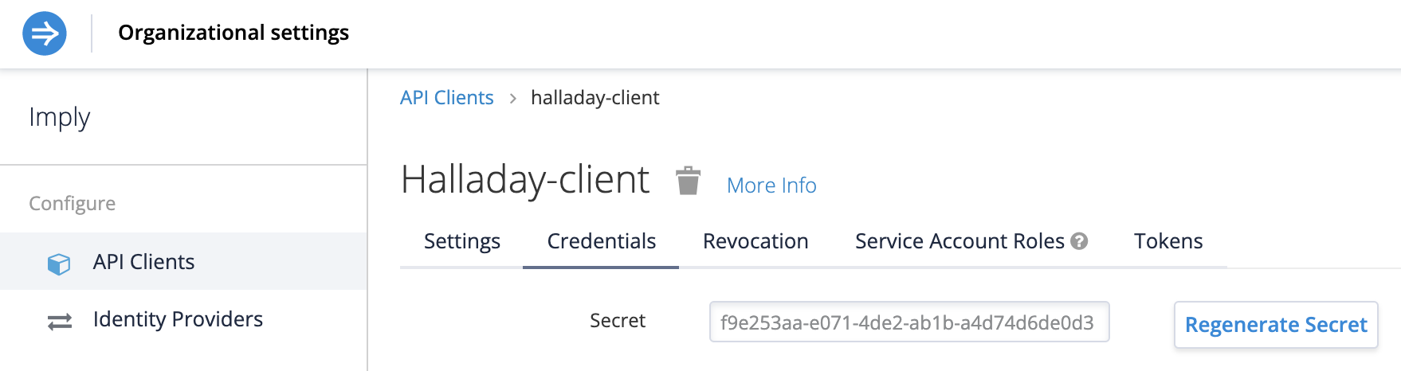


Select the client from the list
Click here
Copy this to the clipboard

Slide 6
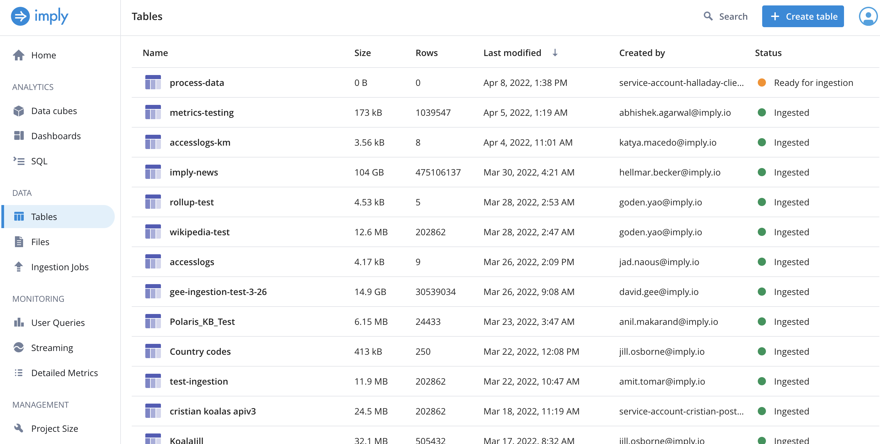

Click here
Then, click here

Slide 7
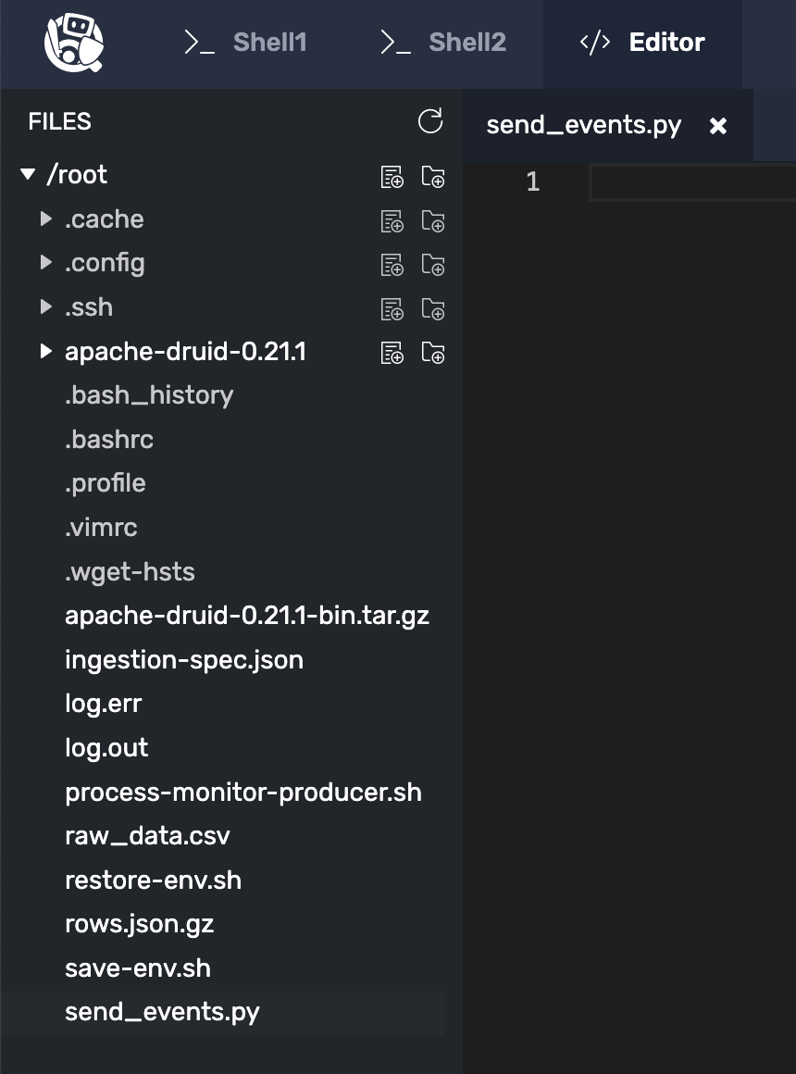
Click here
Then, click here

Slide 8
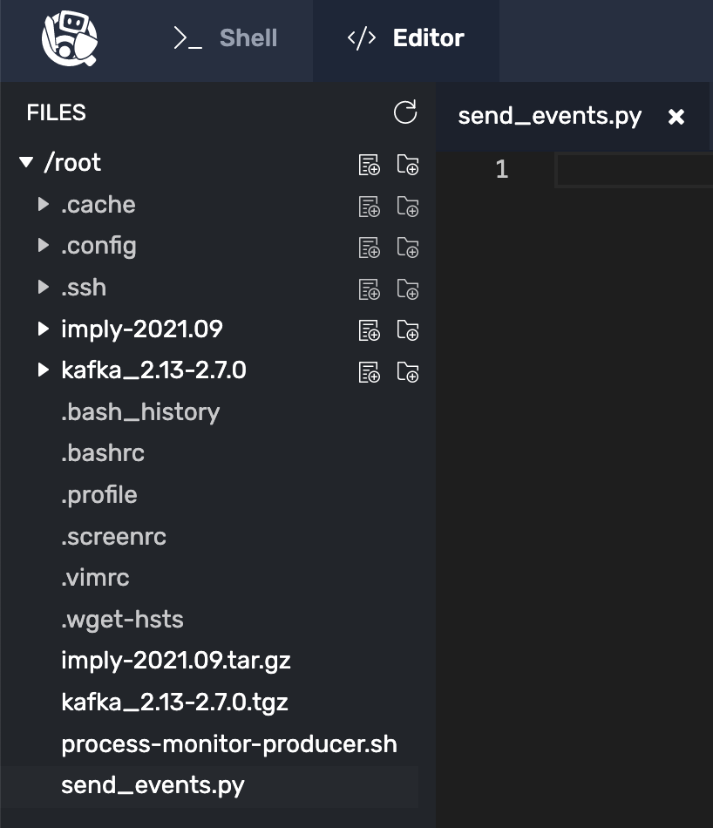
Click here
Then, click here

Slide 9



Click here to save the file
Click here
Click here
Click here

Slide 10

Click here to save the file
Click here
Click here
Click here

Slide 11

Create a Polaris Table

Slide 12
Setting Up a Druid Table
Migration details may vary
But the process is generally the same
SELECT COUNT(*) FROM table

Slide 13
This lesson covers the following:
Set up a local druid table
Signup for a free 60 day Polaris account
Create a Polaris table with a schema
Move the Druid table data to Polaris
Stream data to the Polaris table

Slide 14
Three pieces of info we need:
Organization name
API client ID
API client secret

Slide 15

A note about environment variables:
Our training environment requires us
to refresh them on each challenge.
You don’t need to do this in production.

Slide 16
Polaris Batch Data Migration
Things that may increase program complexity:
Event source
Event format
Type of batching

Slide 17
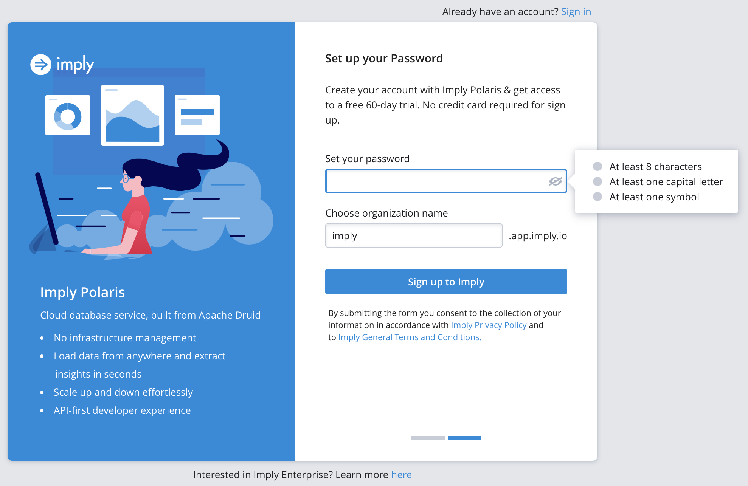


Slide 18
Migrating Data
From
Apache Druid® to Polaris
What is Polaris?
Apache Druid®
Polaris
(SaaS by Imply)

Slide 19


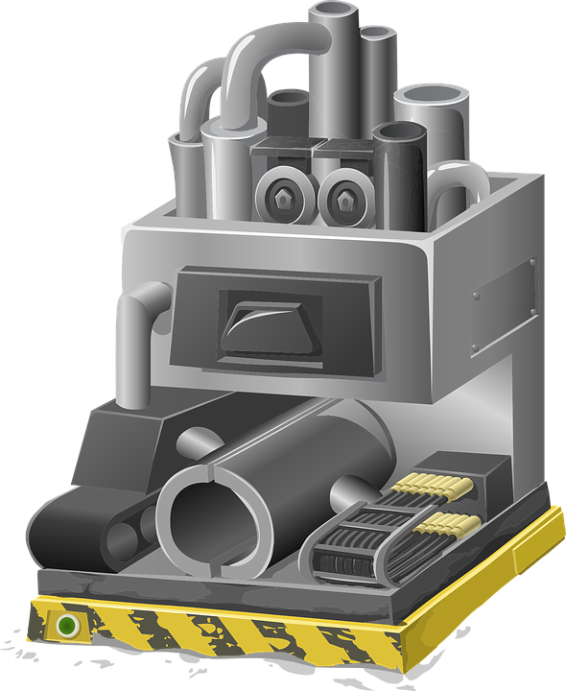
Event Generating
System

Slide 20
__time | ip_address | page_id | user_id

Slide 21



Imply Polaris

Slide 22
Event Generating
System
Imply Polaris

Slide 23

Polaris APIs

Slide 24





Slide 25
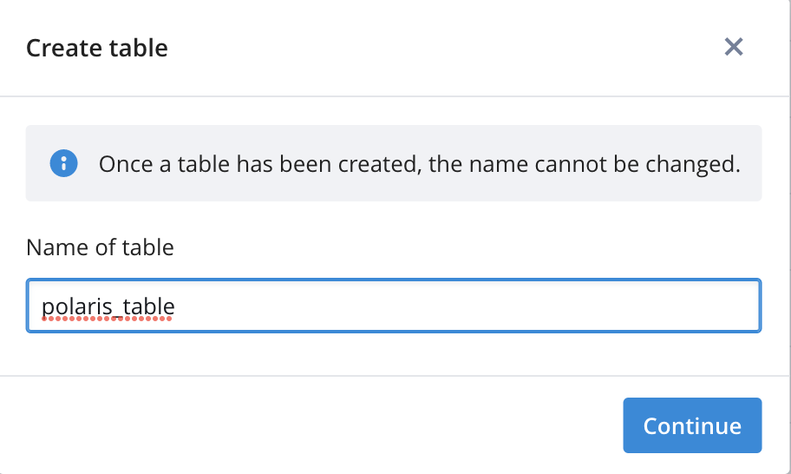
polaris_table

Slide 26
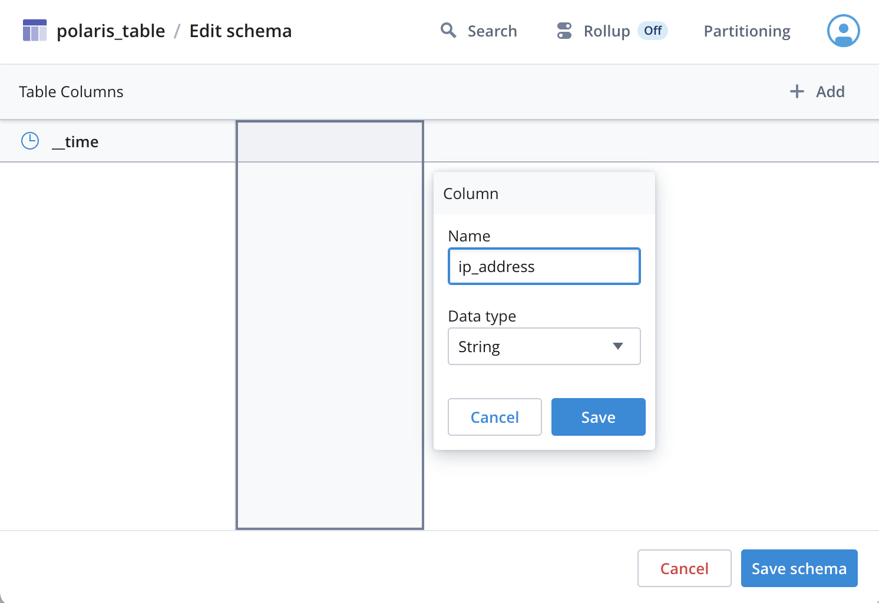

Slide 27

curl --request POST "https://id.imply.io/auth/realms/$ORGANIZATION_NAME/protocol/openid-connect/token" \
--header "Content-Type: application/x-www-form-urlencoded" \
--data-urlencode "client_id=$CLIENT_ID" \
--data-urlencode "client_secret=$CLIENT_SECRET" \
--" \
my_organization
export ORGANIZATION_NAME=my_organization
ORGANIZATION_NAME
my_api_client
CLIENT_ID
CLIENT_SECRET
export CLIENT_ID=my_api_client
my_client_secret
API
export CLIENT_SECRET=my_client_secret
/root/process-monitor-producer.sh ISO CSV 100 > /root/raw_data.csv
/root/process-monitor-producer.sh ISO CSV 100 \
| python3 /root/send_events.py

Slide 28
curl -s -X 'POST' \
-H 'Content-Type:application/json' \
-d '{"query":"SELECT * FROM \"process-data\""}' \
http://localhost:8888/druid/v2/sql \
| jq -c .[] > rows.json
SELECT * FROM “process-data”
echo "" > /root/restore-env.sh
chmod +x /root/restore-env.sh
echo "export ORGANIZATION_NAME=$ORGANIZATION_NAME" >> /root/restore-env.sh
echo "export CLIENT_ID=$CLIENT_ID" >> /root/restore-env.sh
echo "export CLIENT_SECRET=$CLIENT_SECRET" >> /root/restore-env.sh
echo "export IMPLY_TOKEN=$IMPLY_TOKEN" >> /root/restore-env.sh
echo "export TABLE_ID=$TABLE_ID" >> /root/restore-env.sh
echo "export JOB_ID=$JOB_ID" >> /root/restore-env.sh
echo "export TABLE_ID=$TABLE_ID" >> /root/restore-env.sh
echo "export PROJECT_ID=$PROJECT_ID" >> /root/restore-env.sh

Slide 29
{"__time":"2022-04-13T18:59:20.000Z","cpu":16.7,"memory":1.8,"milliseconds":513,"pid":"111","processName":"Broker","seconds":20}
{"__time":"2022-04-13T18:59:20.000Z","cpu":11.1,"memory":1.1,"milliseconds":654,"pid":"114","processName":"MiddleManager","seconds":20}
{"__time":"2022-04-13T18:59:20.000Z","cpu":22.2,"memory":1.3,"milliseconds":283,"pid":"112","processName":"Router","seconds":20}

Slide 30

